Slide 1
Inverted Pendulum Control
Aniket Anbhule, Bethany Calvert, Grace Farson

Slide 2
We chose this system because:
Out of the systems we worked on, it was the most fascinating.
Able to build strong understanding of the dynamic equations
Can directly see how control penalizes each state in system.
We had the most analysis/videos and photos for this system.

Slide 3
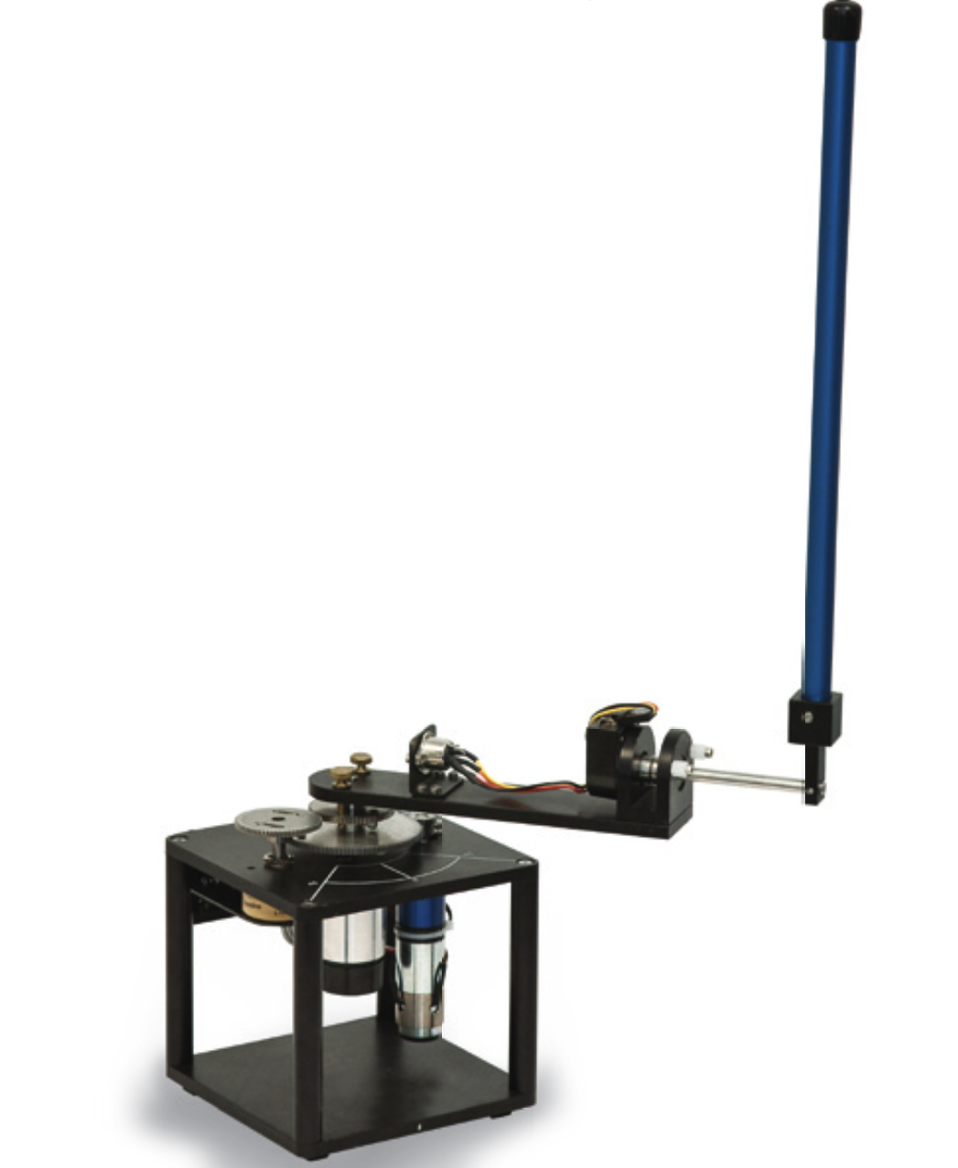
Description - Picture
Goal: Balance pendulum with FB control from upright/unstable position
Nonlinear system
4 states: 𝛳, 𝛳’, 𝛼, 𝛼’
Linearized equations valid within ±15°
𝛼
𝛳

Slide 4
Design Process
Create mathematical model for inverted pendulum
Design position controller to maintain the pendulum in the upright unstable position
Design controller to inject energy/oscillate pendulum
Design a mode controller to determine when to switch between the destabilizing controller and the stabilizing controller.

Slide 5
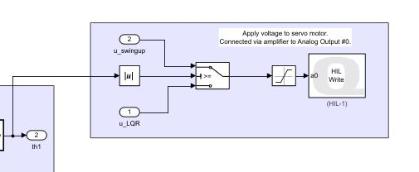
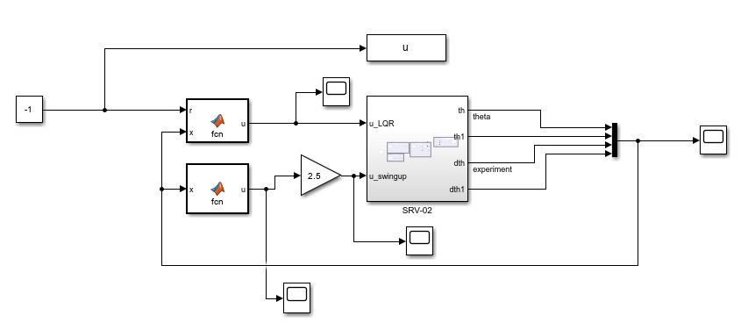
Simulink Model

Slide 6
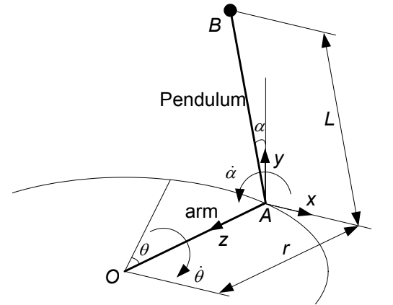
Mathematical Model
Due to complexity, the model was derived mathematically
Non-linear dynamics were found using Lagrange’s Equations
Linearizing these equations produced our system model

Slide 7
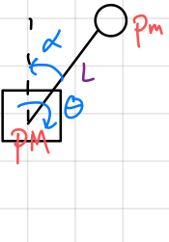
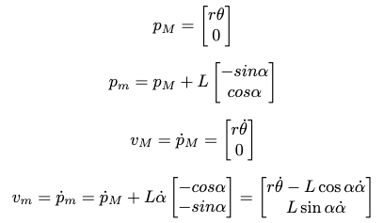
Nonlinear Equation Derivation
Define position and velocity in terms of state variables

Slide 8
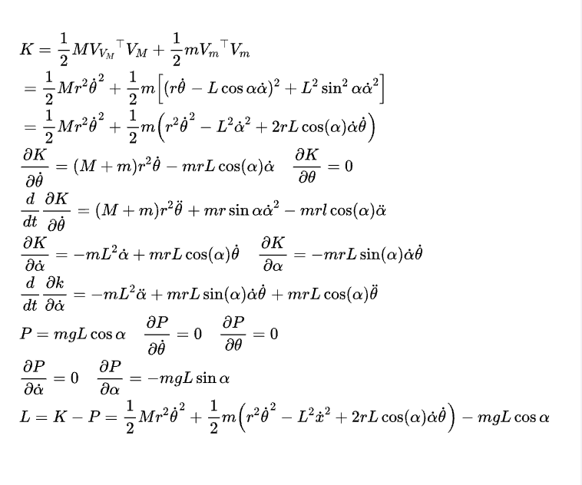
Nonlinear Equation Derivation Cont.
Derive potential and kinetic energy terms of states

Slide 9
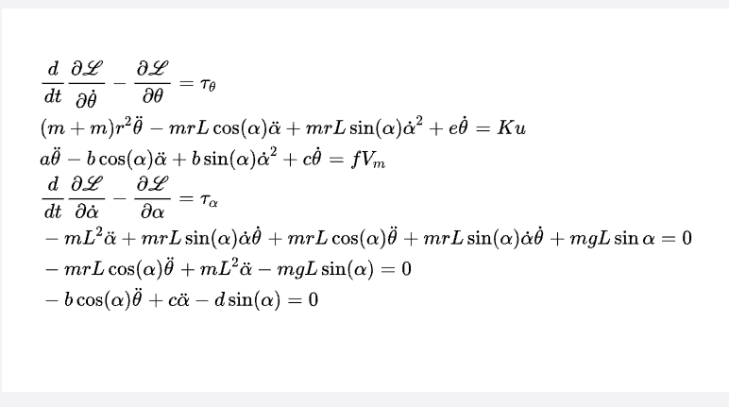
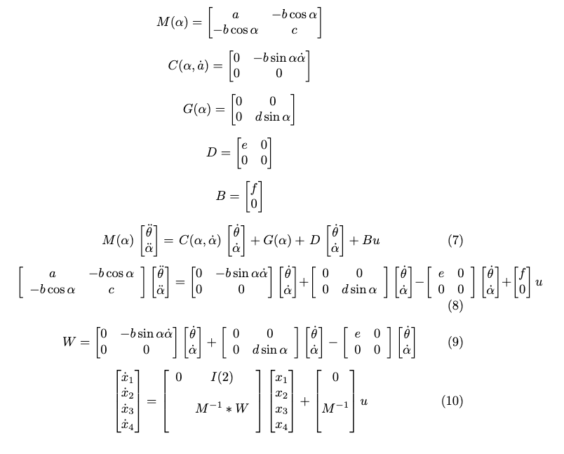
Nonlinear Equation Derivation Cont.
Derive Lagrangian Dynamics

Slide 10
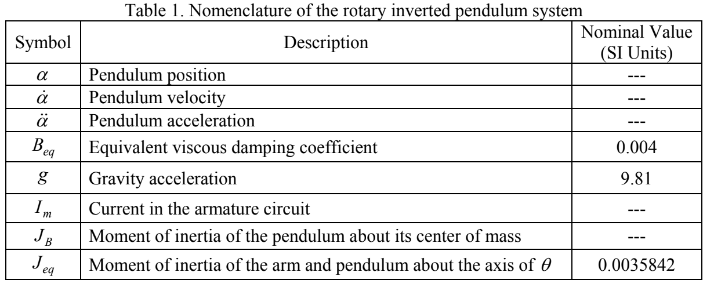
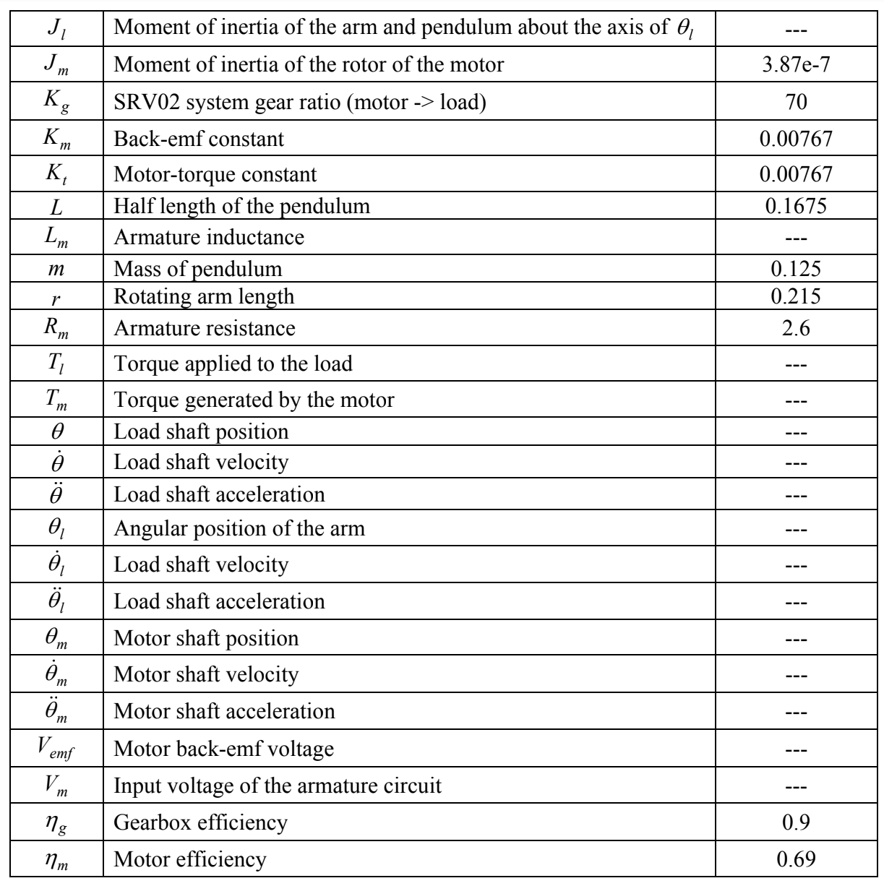
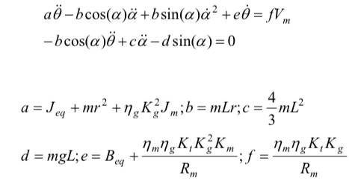
Equation Parameters

Slide 11
Nonlinear State Space Model
Taking the nonlinear equations, the state space formulation is as follows:

Slide 12

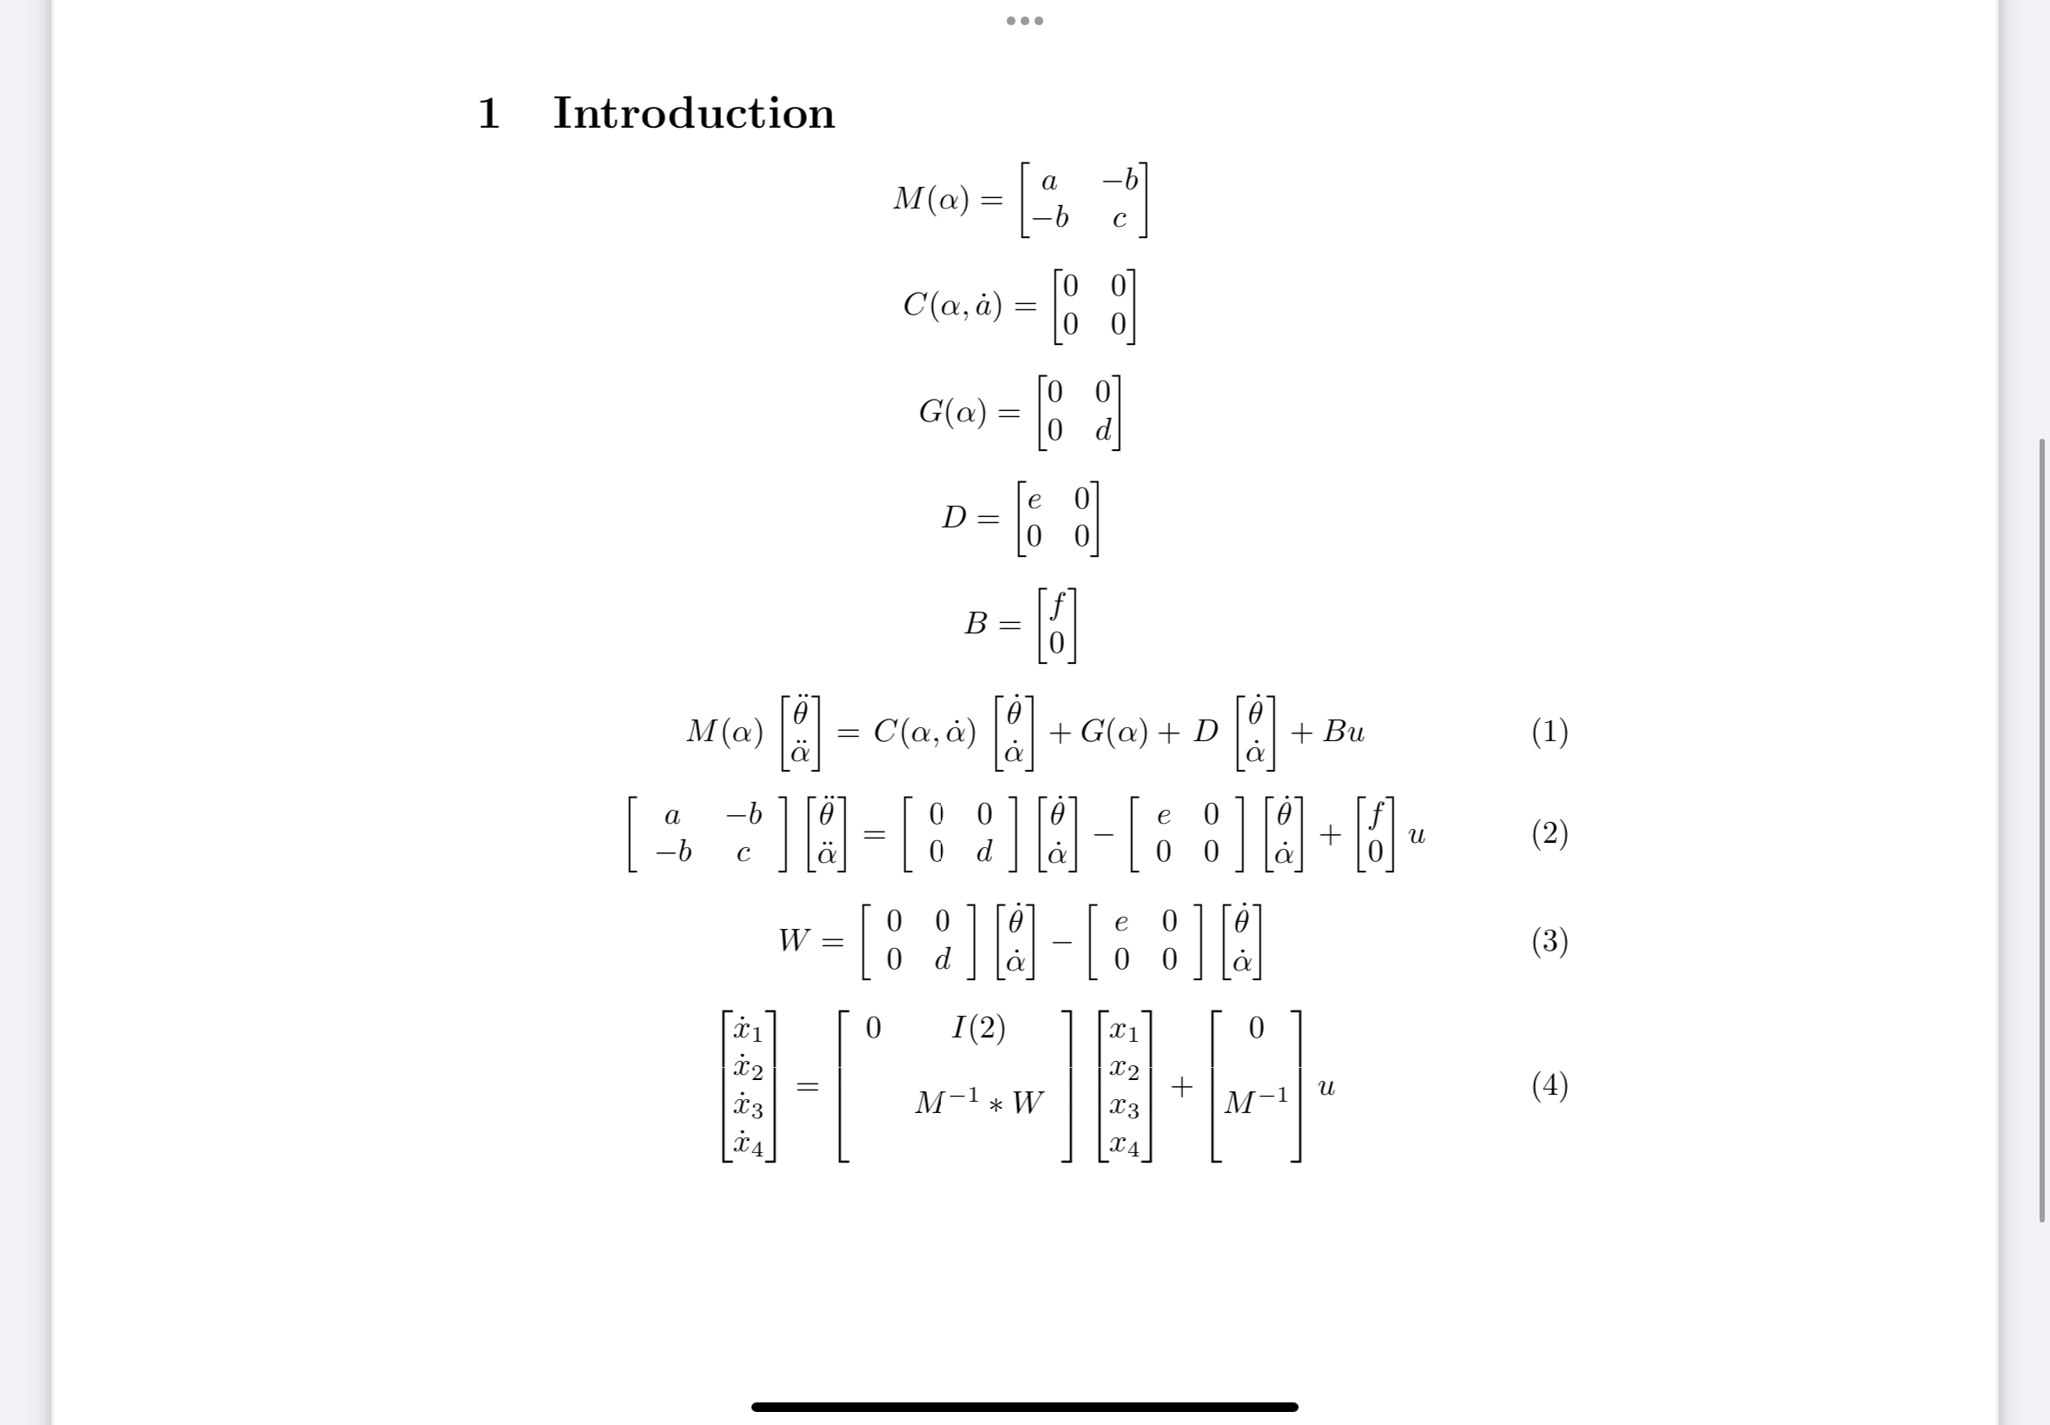
Linearized State Space Model
Using a=a’=0, the linearized equations are:
The state space model is:

Slide 13
Control Design - LQR
Why LQR Control:
Ability to penalize specific states
Most efficient due to complexity of system
Easier to implement state feedback
Tuning and Design:
Defining and changing nominal values

Slide 14
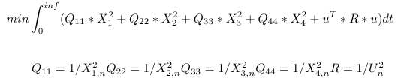
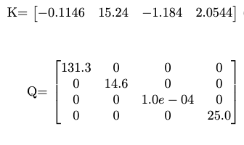
Design Process - LQR
standard equation
Define nominal values:
U_n = 0.1
X_1,n = 0.1*deg2rad(50)
X_2,n = deg2rad(15)
X_3,n = 100
X_4,n = 0.2
Cutoff freq: w1 = 200
Changing w1 reduces oscillations

Slide 15
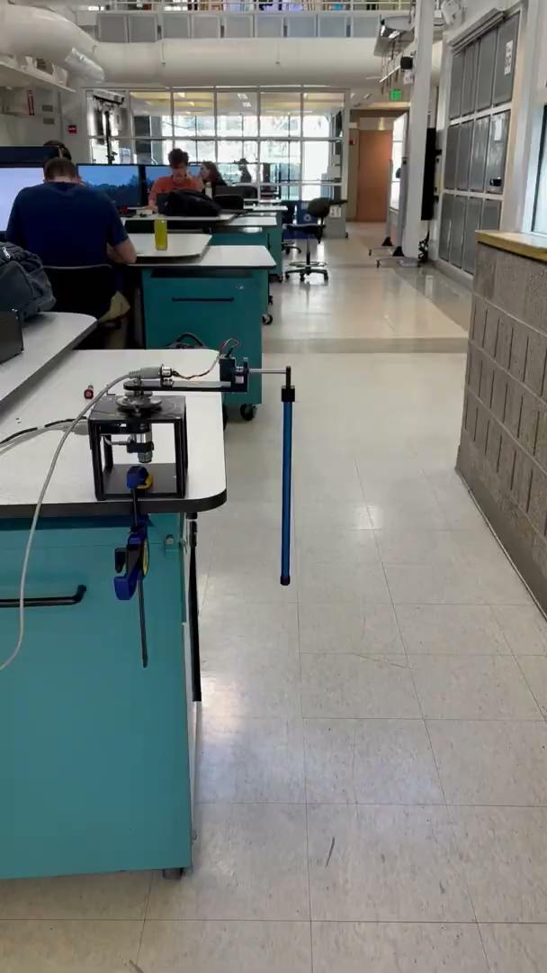
Result

Slide 16
References
Diao, X. (Year). "Modular Control of a Rotary Inverted Pendulum System." School of Engineering Technology, Purdue University, West Lafayette, IN, USA.
Quanser Inc. (2012). "Inverted Pendulum Experiment: Set Up and Configuration." Retrieved from Quanser Inc. website. Available at: http://www.quanser.com/

